Slide 1

Safety floater
IoT group project for coastal tourism
Blue Growth
Daniele Bufalieri, Marco Calamo, Ivan Giacomoni

Slide 2
What is the problem?
The problem is the security of swimmers because of the boats that do not respect the safety distance from the coast.
It is a threat for the tourists and also for the environment because the pollution near the shore.
There is not a direct communication to the authorities

Slide 3
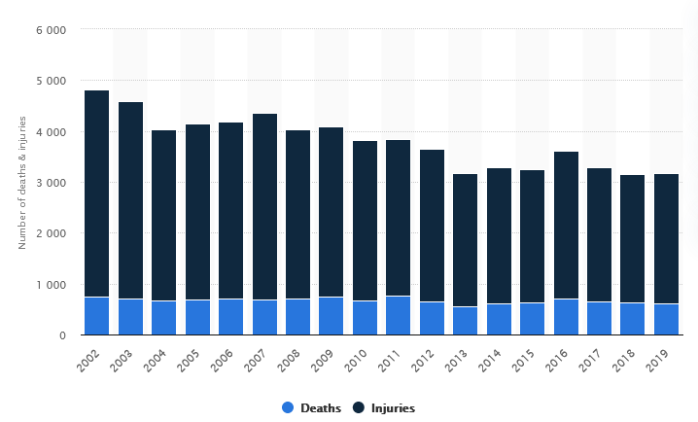
Boat accidents FROM 2002 TO 2019

Slide 4
Key functionalities
Real time reporting to authorities of violations
Create a safer holiday for tourists
Improve water quality near the shore
Decrease number of accidents
Provide an user friendly dashboard in order to monitor violations

Slide 5
Iot architecture
LoraWAN
MQTT
MQTT
Safety Floater
Sea Station
Cloud Server
Frontend
REST

Slide 6
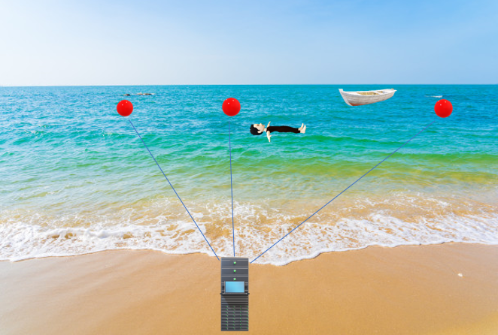
Red points represent Safety Floaters
Server represents the Sea Station
Blue links represent the communication
by LoraWAN

Slide 7
Technology: safety floater
It’s the key component: floater with sensors and actuators that monitor boats’ illegal transit
The main board is NUCLEO STM32 F401RE with RIOT OS
Sensors are proximity ultrasonic sensor SR04 for movement detection in water, 9-Axis magnetometer gyroscope accelerometer for orientation MPU-9250, GPS if possible
Actuators are DC motors for correct orientations of SR04 and a buzzer for audio report
Communications via LoraWAN to Sea Station with sensors data

Slide 8
Technology: SEA STATION
It is the bridge between the Cloud and Safety Floater, it is another NUCLEO STM32 F401RE board with RIOT OS
It elaborates sensor data: if a violation is detected sends a notification via MQTT to IoT Core and takes pictures
The notification is sent by MQTT through the violation topic while the data are saved into the cloud through the data topic

Slide 9
Technology: CLOud server & FRONTEND
Cloud Server is based on AWS, stores data from MQTT to DynamoDB
Cloud Server hosts frontend on EC2 instance
Frontend is developed in Javascript, Bootstrap, HTML, NodeJS and VueJS
Frontend is designed for 2 kind of users: common users and coast guards
Data are obtained by REST API

Slide 10
Sensors & data collected
MPU-9250 9DOF Module 9 Axis Gyroscope Accelerometer Magnetic Field Sensor
HC-SRF04 Proximity sensor
GPS
Voltage consumption sensor

Slide 11
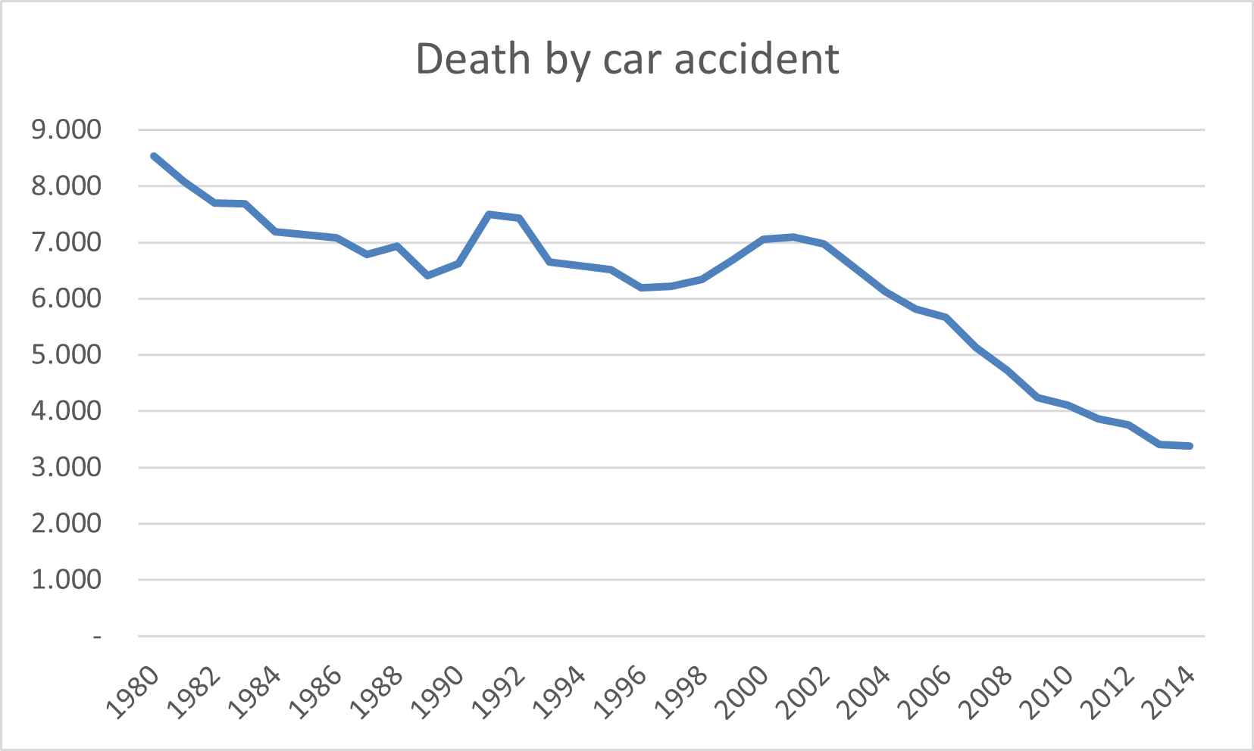
Collective intelligence
Our purpose is to replicate this trend of death by car accident since autovelox was introduced, but in the context of accident caused by boats introducing our system in order to prevent an increasing number of deaths.

Slide 12
Actuators
Acoustic alarm
Visual alarm
Camera
DC motor

Slide 13
evaluation
Network technologies
Given that Safety Floater will communicate with the Sea Station via LoraWAN, the evaluation of the performance of the network technologies will be measured with Iot-lab, because there we have the right tools compared to a generic user. We want to notice that we are not able to analyze the network consumption of physical devices of our personal Safety Floater.
Embedded devices
During the development phase we will use Iot-lab to have an estimation of the power consumption of the embedded device (Nucleo f401-re), because even if on Iot-lab are not available our specific sensors we can obtain a rough result. During the final testing we will use a voltage measure sensor in order to monitor the real consumption.
End-user point of view
From an end-user point of view the response time is conditioned by LoraWAN, by the bandwith of the channel linking the Sea Station to the cloud, and by the type of protocol used (e.g.: HTTP-REST / MQTT). From a quantitative point of view, we will use timestamps at the generation of the packet and one at the receiving of the packet.

Slide 14
Constraints
All sensors are constantly sampled
Bandwith and latency limitated by the capacity of LoraWAN
Waterproof sensors
Energy is a key factor in Safety Floater, we use solar panel in order to increase the battery life
Power consumption reduced at minimum

Slide 15
PERFOMANCE EVALUATION
Battery life: it’s crucial because these are stand alone device (mAH and V)
Latency: is the most important factor because Safety Floater is a real time system (ms)

